Slide 1

Self-supervised Learning of Reconstructing Deformable Linear Objects under Single-Frame Occluded View
Song Wang, Guanghui Shen, Shirui Wu and Dan Wu
Department of Mechanical Engineering, Tsinghua University

Slide 2
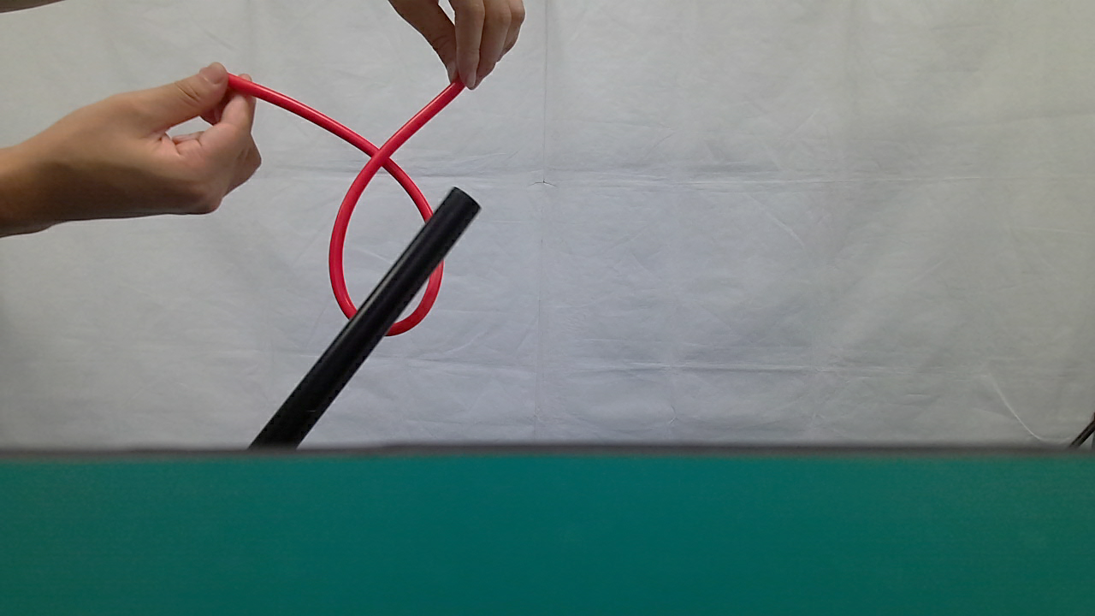
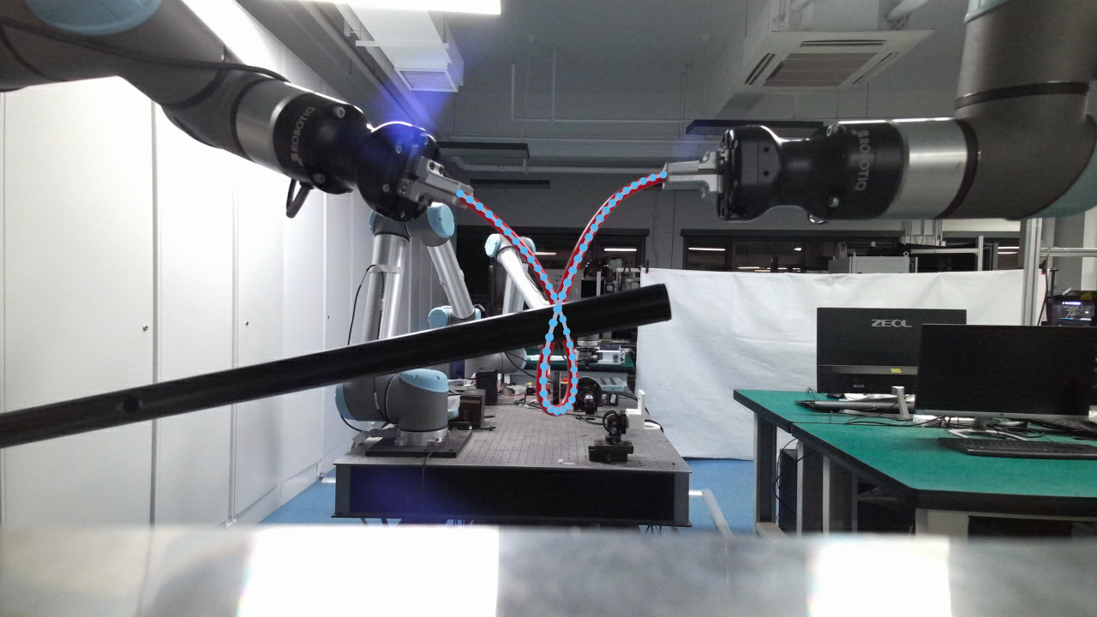
Highlights
3D efficient self-supervised DLO reconstruction algorithm:
Efficient No-Label Training: Enables data collection in real-world settings, even manually.
Robust 3D State Inference: Reconstructs DLO from a single frame, even with severe occlusions.
Training Stage
Inference Stage
Occluded DLO
Reconstructed Key Points
1

Slide 3


Framework
Self-supervised DLO occlusion single-frame reconstruction framework:
A. Self-supervised DLO Point Cloud Completion
B. Ordered Key Points Generation
A
Encoder
Decoder
Update
DLO Smooth
Elongated Shape
Patchification
Memory Module
Resample
Partial Point Cloud
Direction Embedding
Complete Point Cloud
2

Slide 4
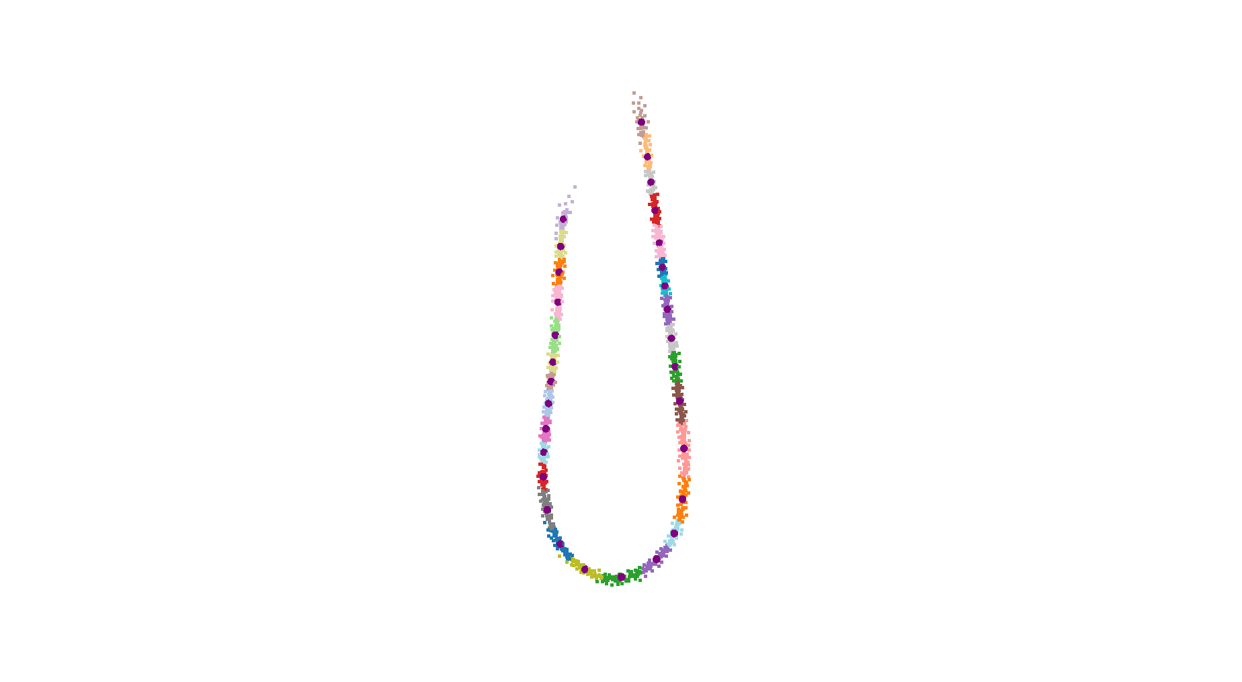
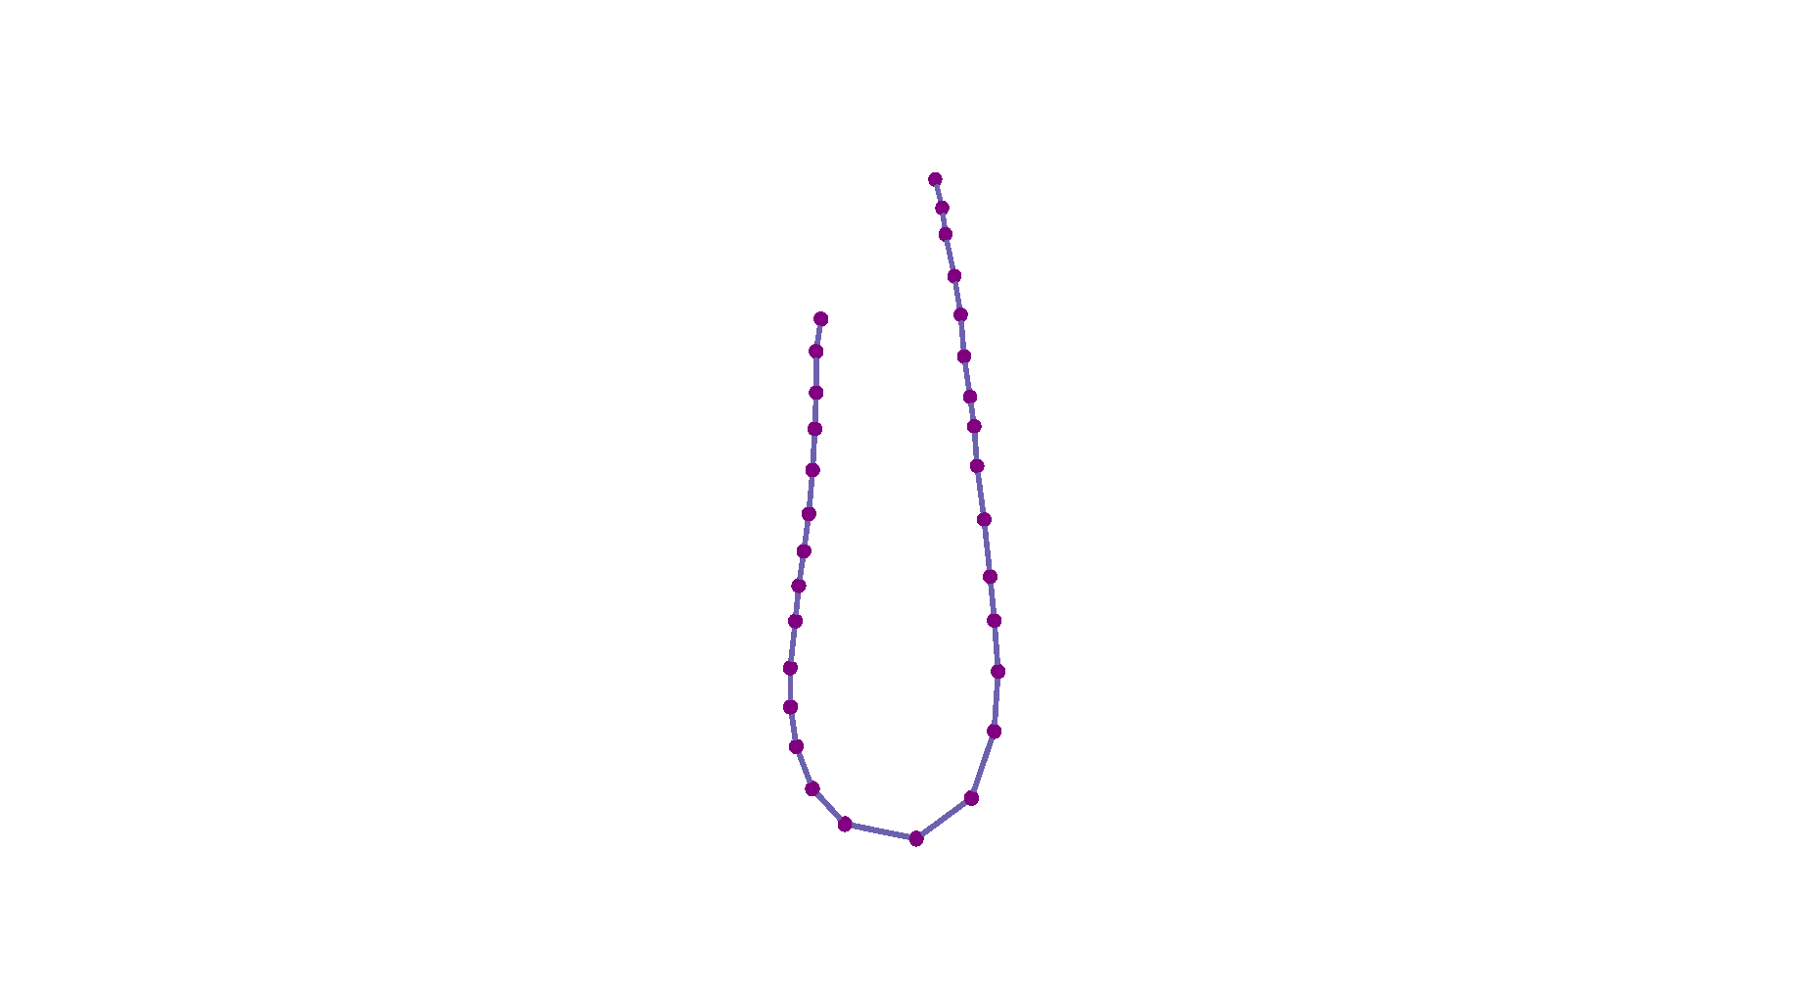


Framework
Self-supervised DLO occlusion single-frame reconstruction framework:
A. Self-supervised DLO Point Cloud Completion
B. Ordered Key Points Generation
B
Clustering
Sorting
B-Spline Fitting
Resampling
Unordered Key Points
Ordered Key Points
B-Spline Curve
Reconstructed Key Points
3

Slide 5

Innovations
Memory module
DLO shape constraints
Clone & Expand
max pooling
DLO smooth loss
Elongated shape loss
Extract memory across samples by max pooling
to reinforce the supervisory signals.
Integrate DLO priors, like smooth and elongated shapes, to enhance reconstruction performance.
4

Slide 6
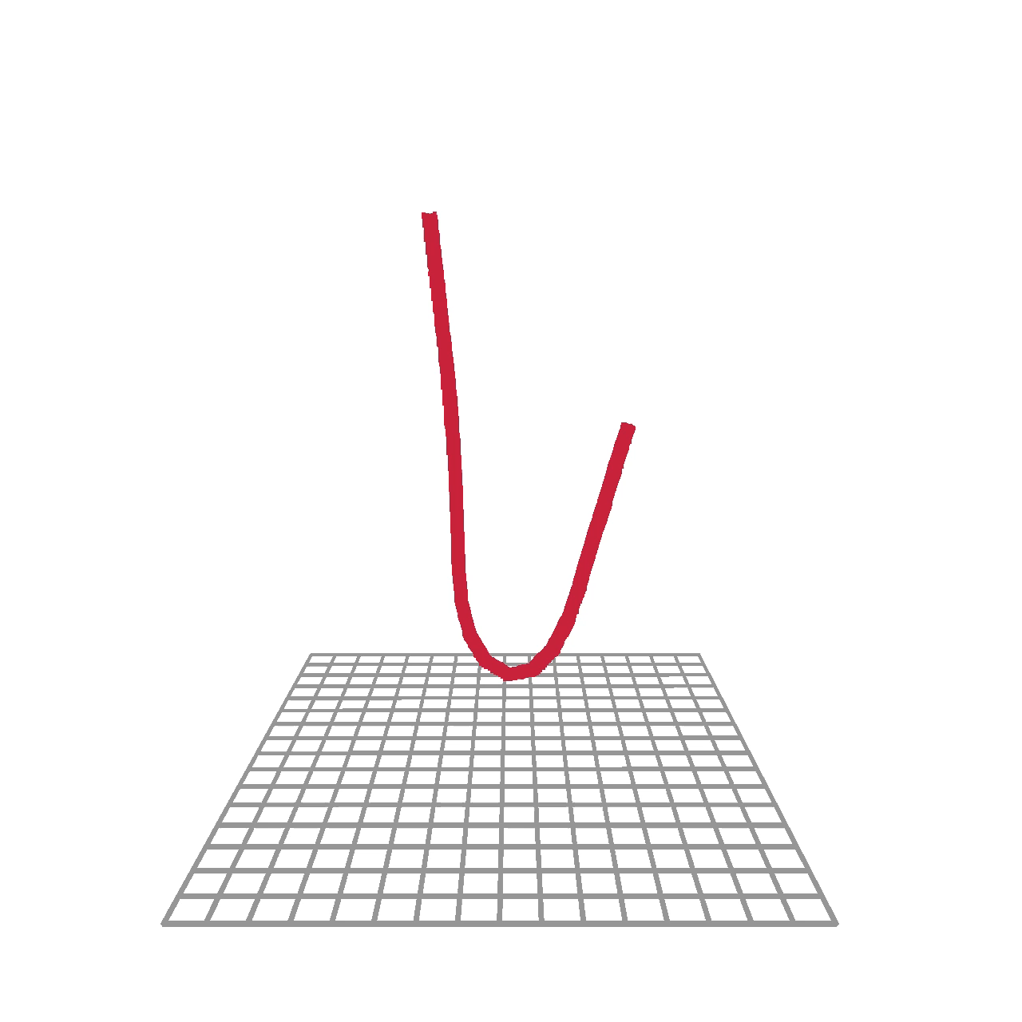
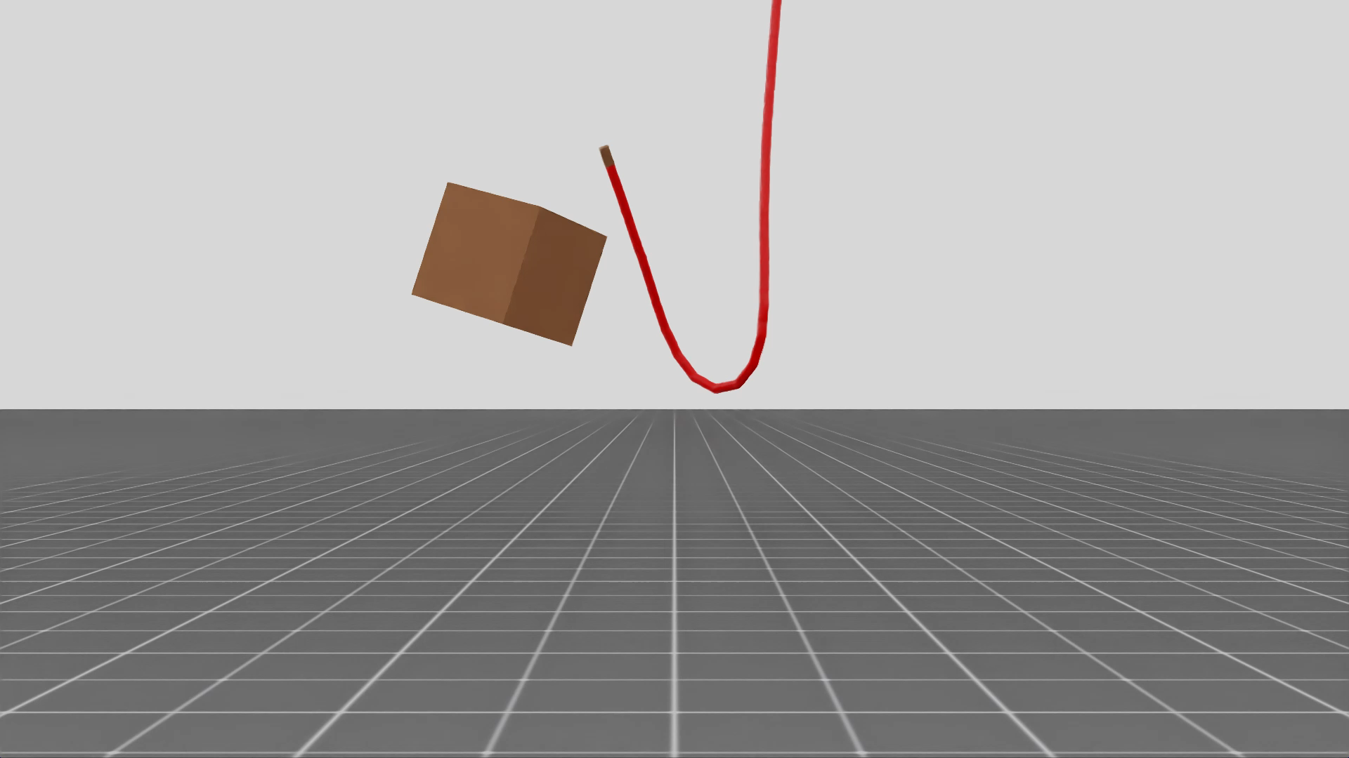
Experiments
Simulation Experiments—Synthetic Dataset Generation
The DLO has randomly moving endpoints, while an occlusion cube moves to simulate occlusions.
7,000 DLO samples, split into training, validation, and test sets with an approximate 7:2:1 ratio.
5

Slide 7
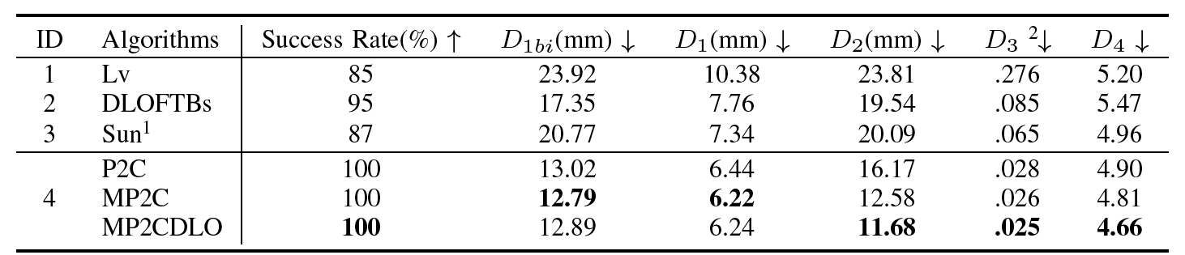
Experiments
Simulation Experiments—Results
Evaluation metrics comparison and ablation study on synthetic DLO datasets.
[1]
[2]
[3]
P2C: Original P2C[4] in our framework.
MP2C: P2C with our memory module.
MP2CDLO: MP2C with our DLO shape constraints.
[1] K. Lv, M. Yu, Y. Pu, X. Jiang, G. Huang, and X. Li, “Learning to estimate 3-d states of deformable linear objects from single-frame occluded point clouds,” in 2023 IEEE International Conference on Robotics and Automation (ICRA). IEEE, 2023, pp. 7119–7125.
[2] P. Kicki, A. Szymko, and K. Walas, “Dloftbs–fast tracking of deformable linear objects with b-splines,” in 2023 IEEE International Conference on Robotics and Automation (ICRA). IEEE, 2023, pp. 7104–7110.
[3] S. Zhaole, H. Zhou, L. Nanbo, L. Chen, J. Zhu, and R. B. Fisher, “A robust deformable linear object perception pipeline in 3d: From segmentation to reconstruction,” IEEE Robotics and Automation Letters, vol. 9, no. 1, pp. 843–850, 2023.
[4] R. Cui, S. Qiu, S. Anwar, J. Liu, C. Xing, J. Zhang, and N. Barnes, “P2c: Self-supervised point cloud completion from single partial clouds,” in Proceedings of the IEEE/CVF International Conference on Computer Vision, 2023, pp. 14 351–14 360.
6

Slide 8
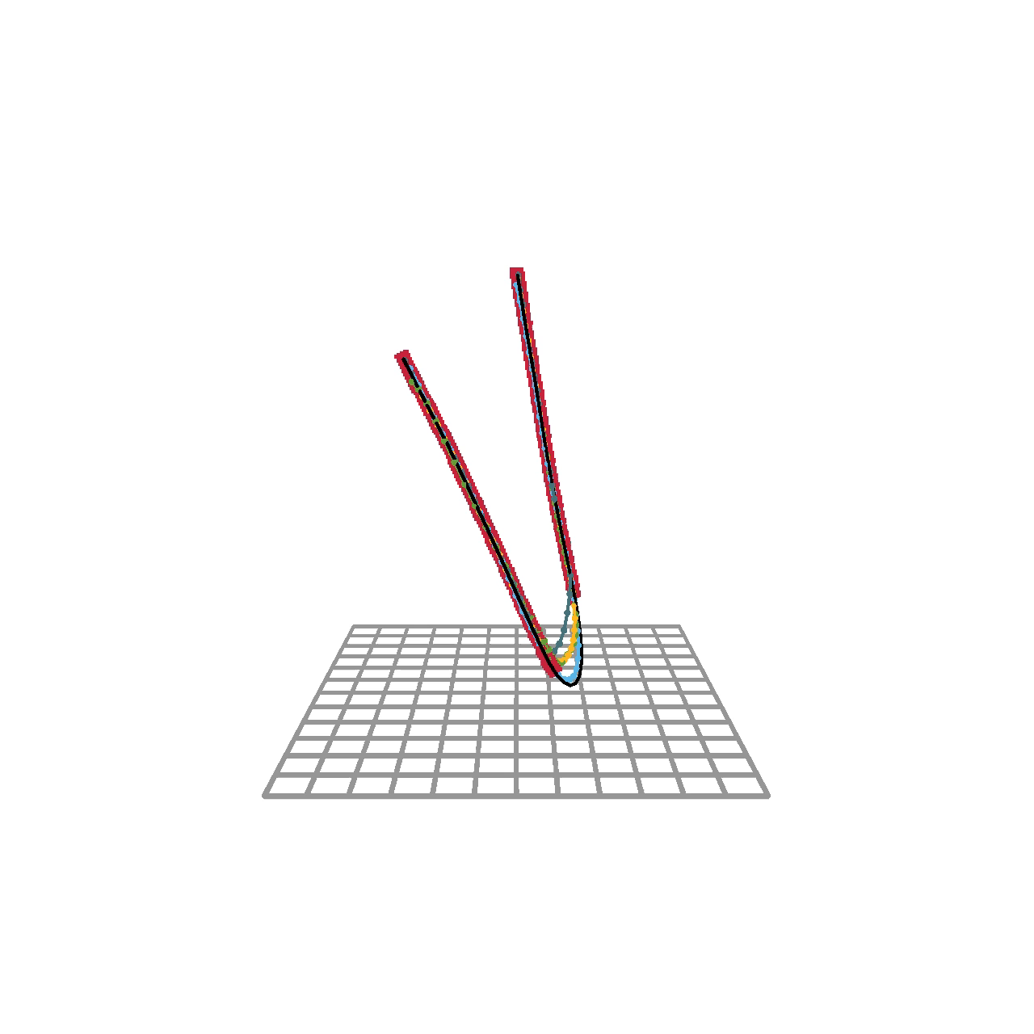
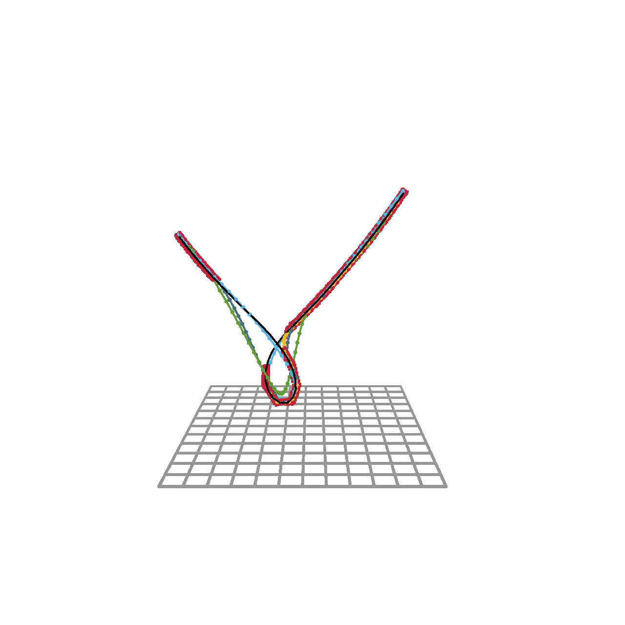
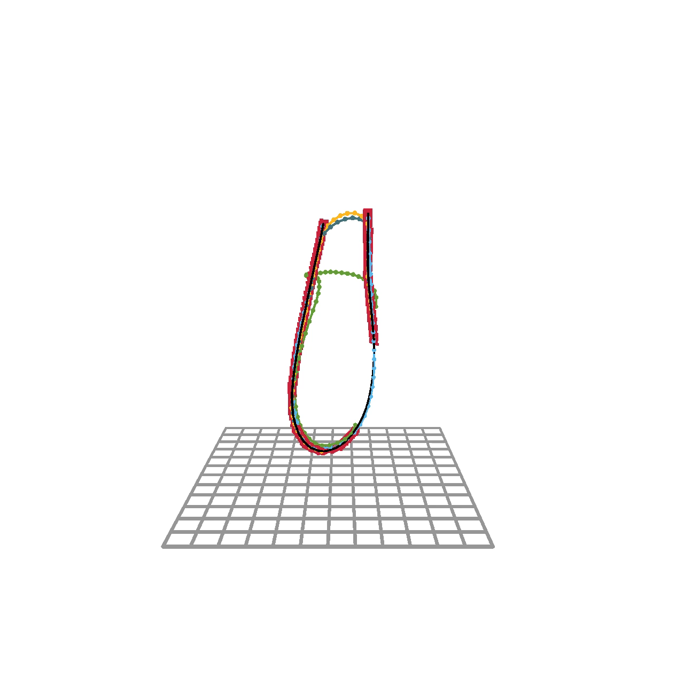
Experiments
Simulation Experiments—Results
Reconstruction visualization comparison on synthetic DLO datasets.
Input
Ground Truth
Lv
DLOFTBs
Sun
MP2CDLO (Ours)
7

Slide 9
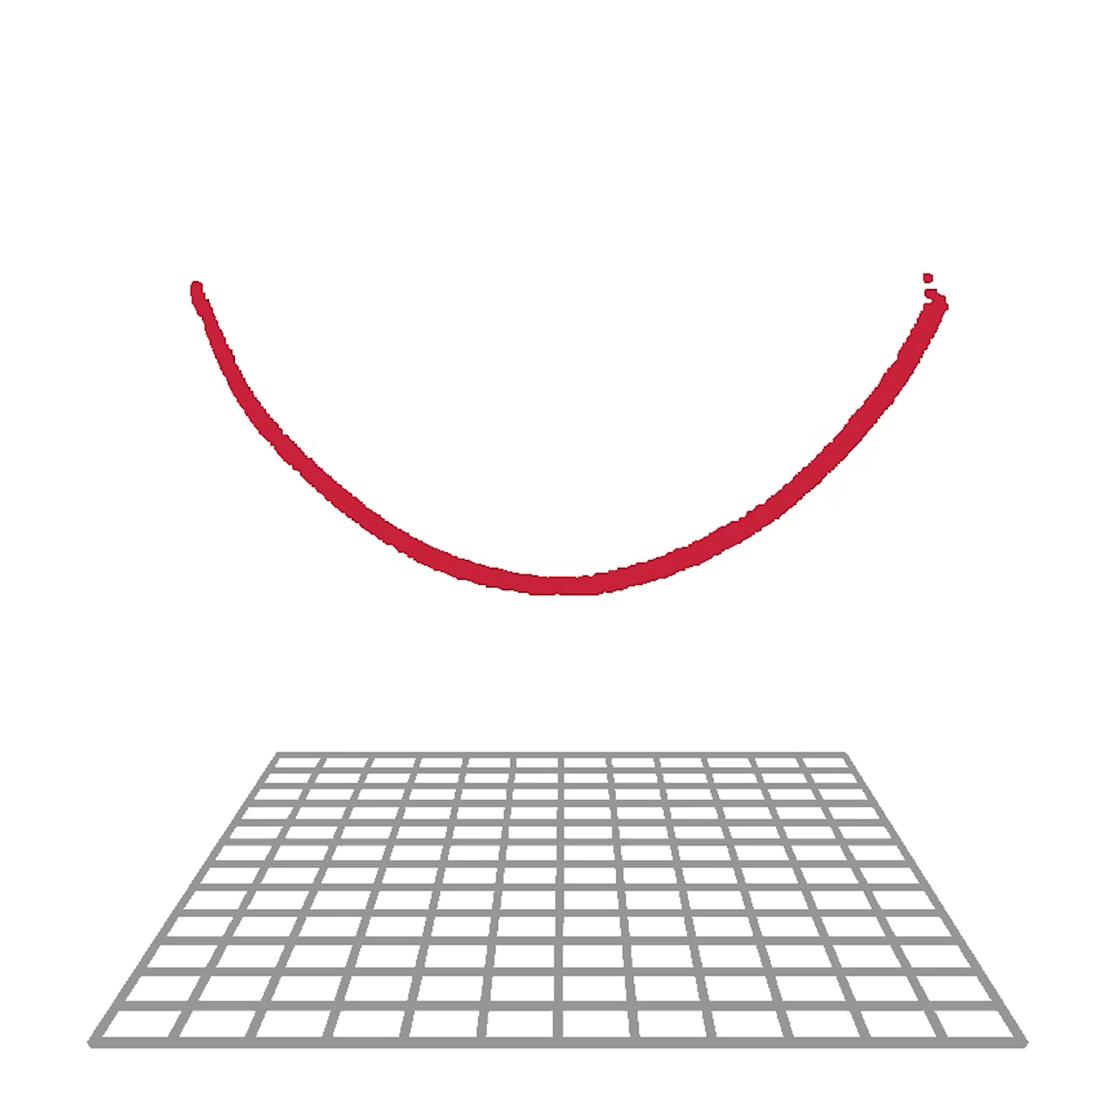
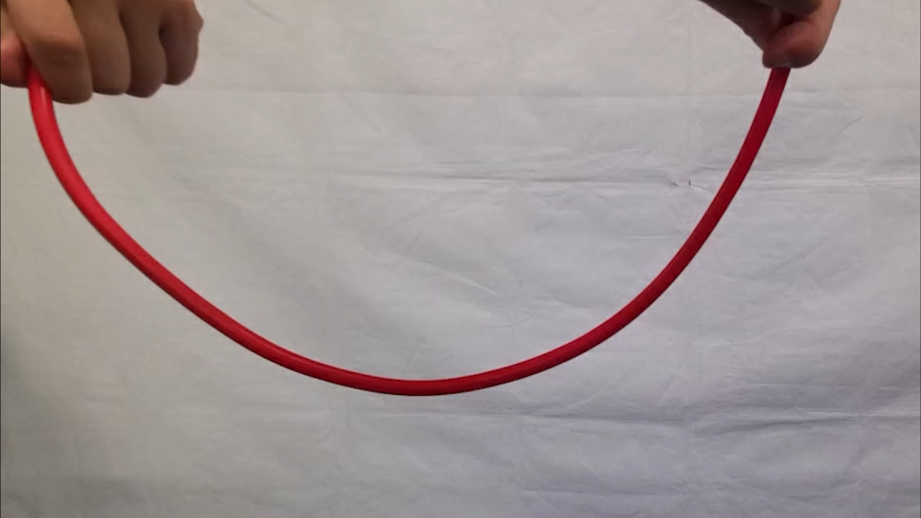
Experiments
Real-world Experiments—Training Stage
Simplify data collection by manual manipulation of both ends of the DLO under an RGB-D camera.
8

Slide 10
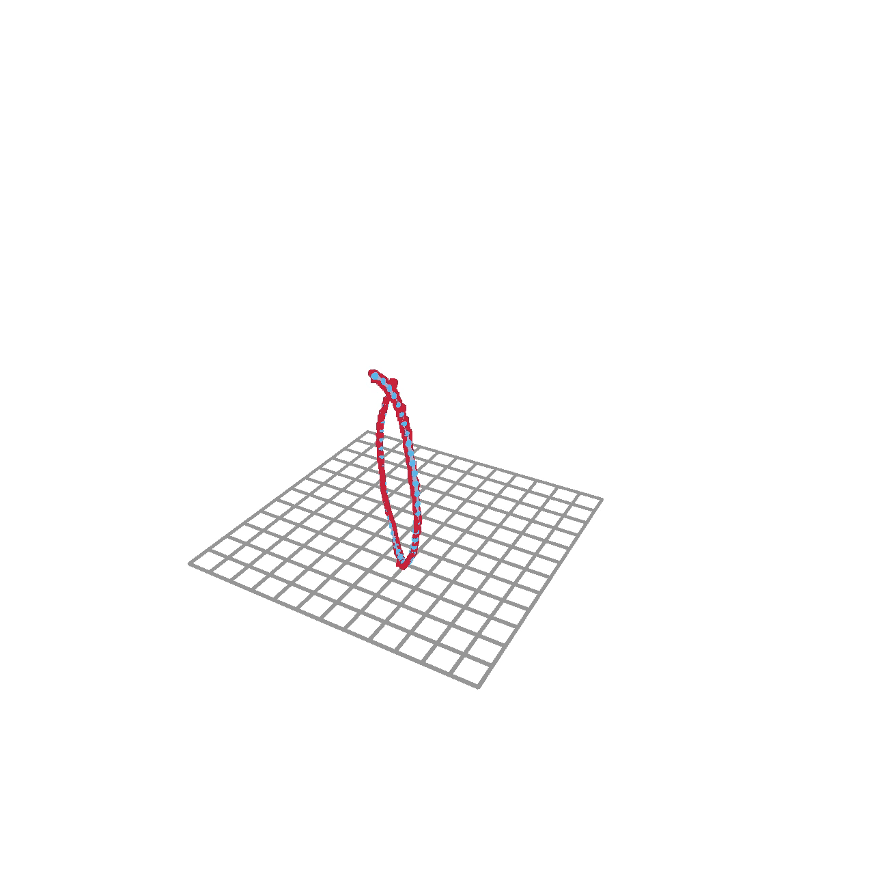
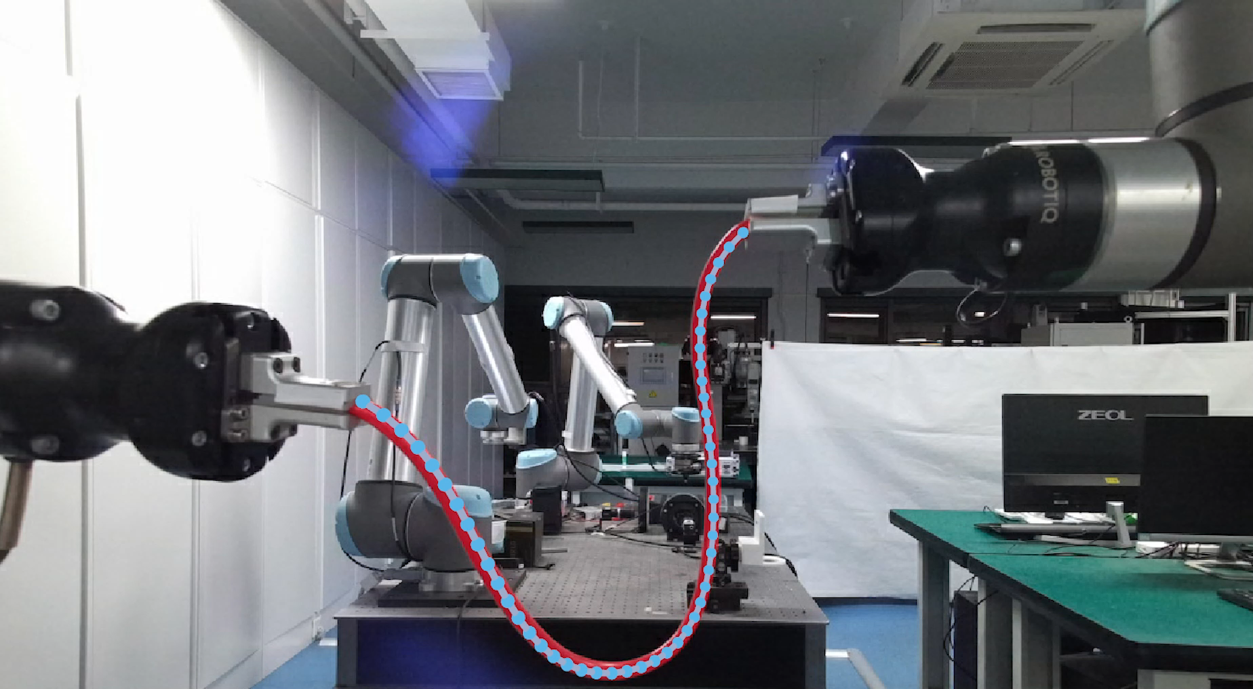
Experiments
Real-world Experiments—Inference Stage
Normal Scenario: Occasional occlusions occur when two arms manipulate the DLO.
9

Slide 11
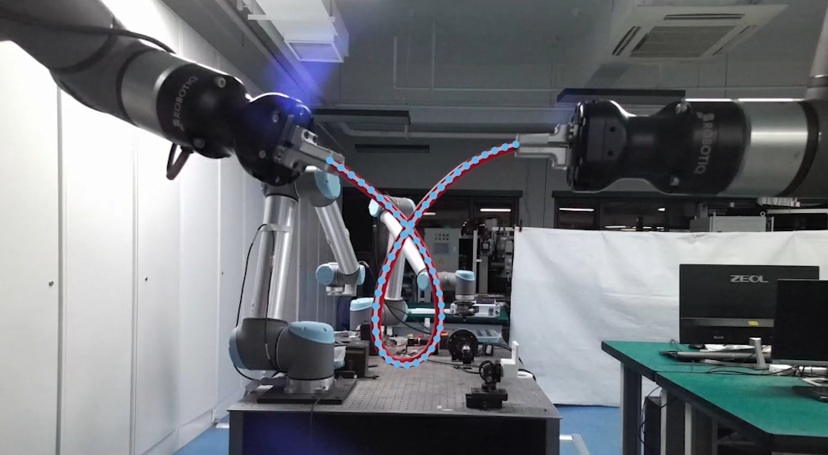
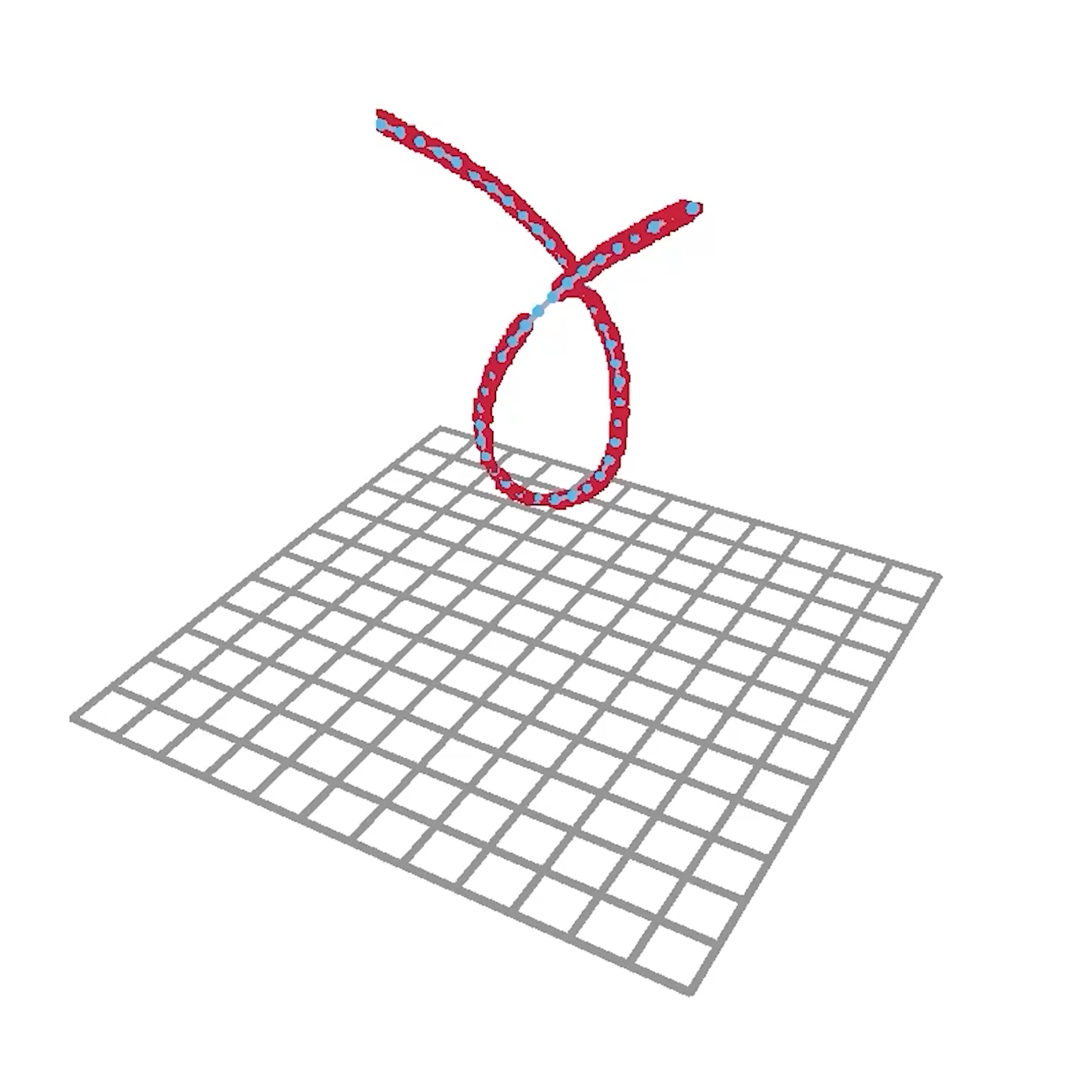
Experiments
Real-world Experiments—Inference Stage
Complex Scenario: Both occlusions and various self-intersections may occur simultaneously.
Speed×1.5
10

Slide 12
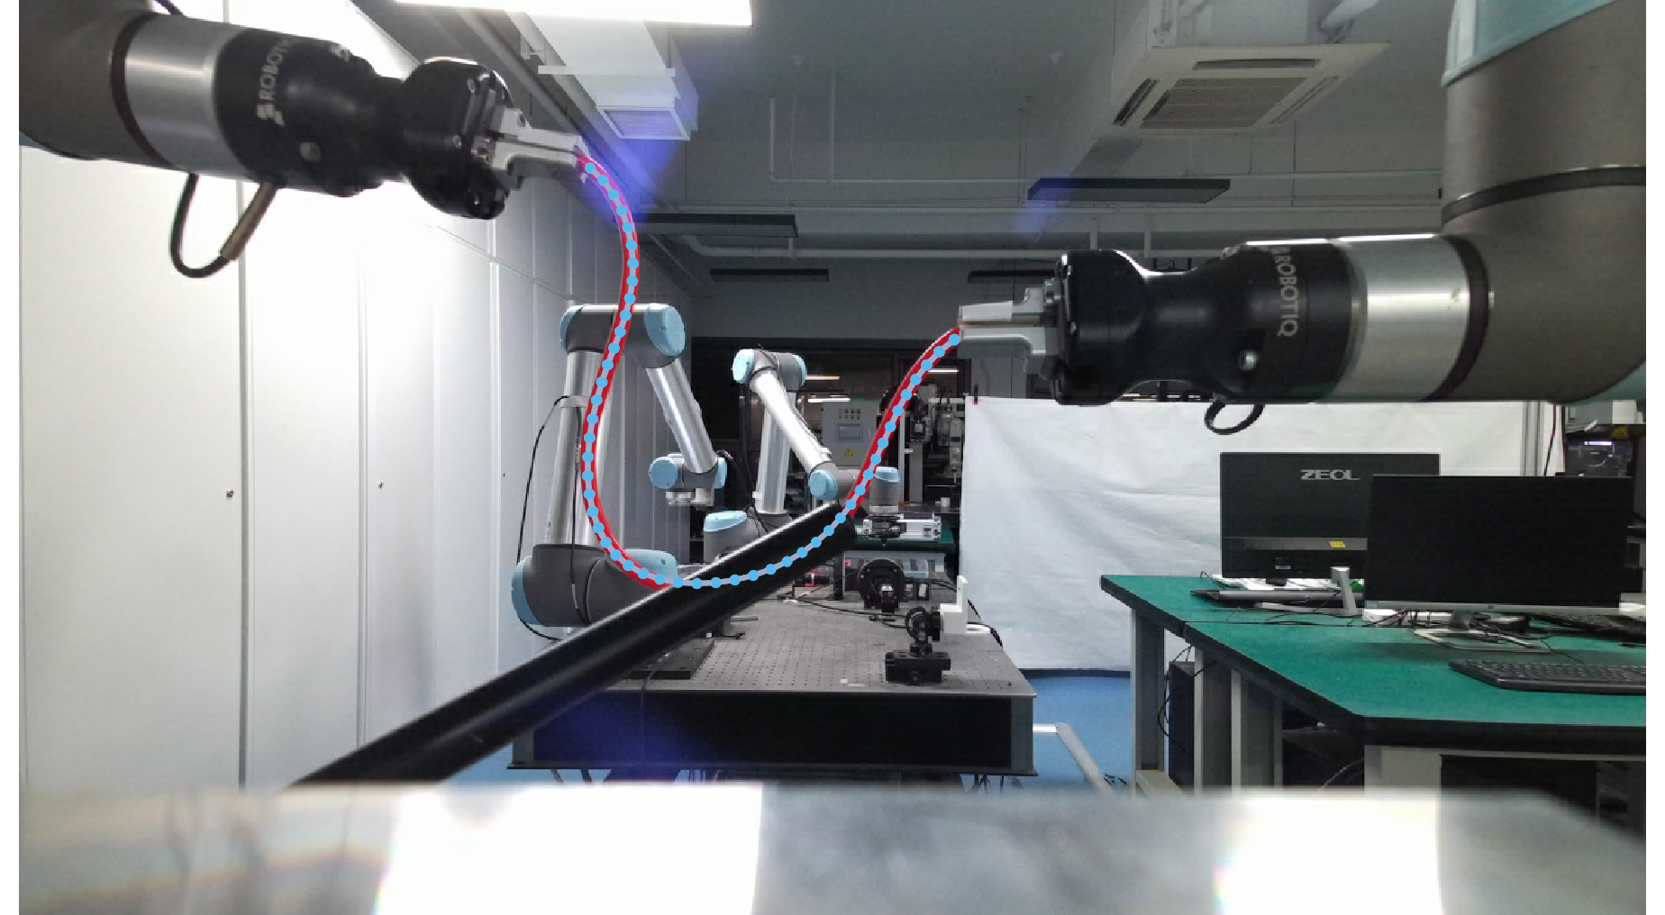
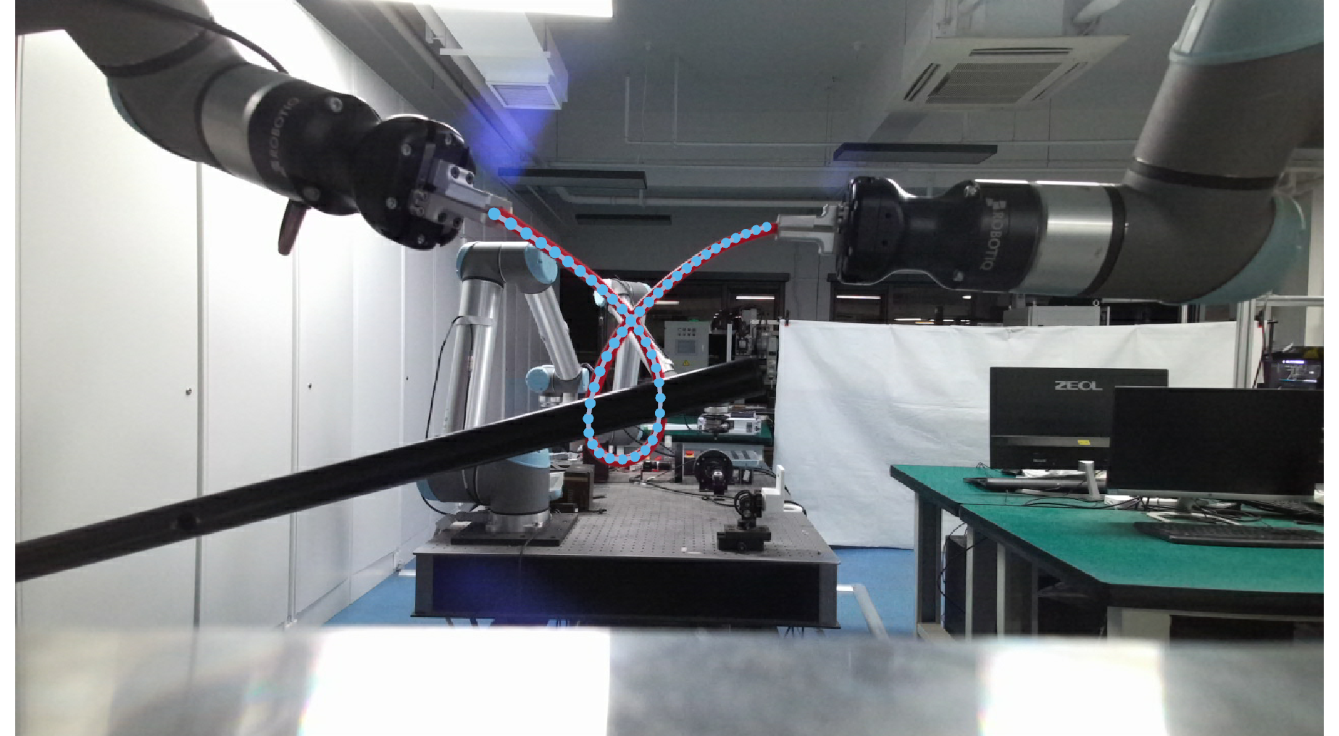
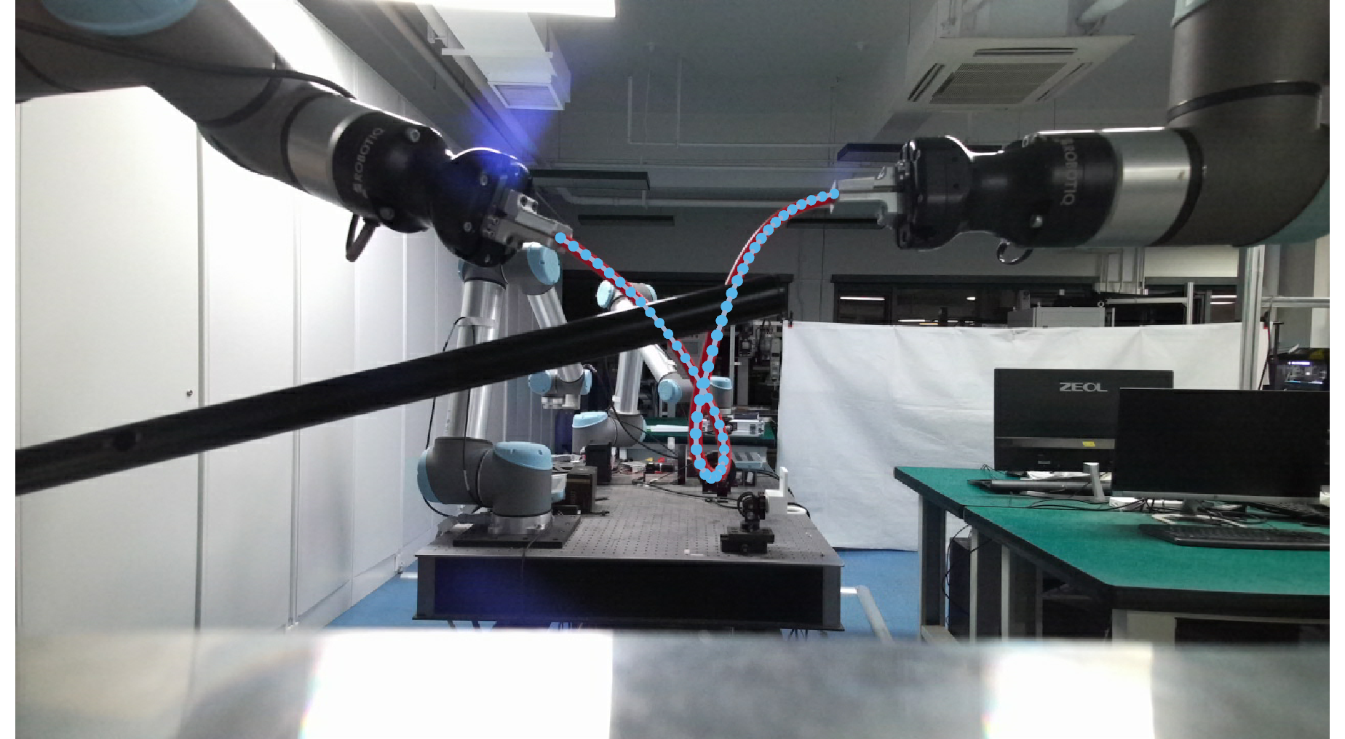
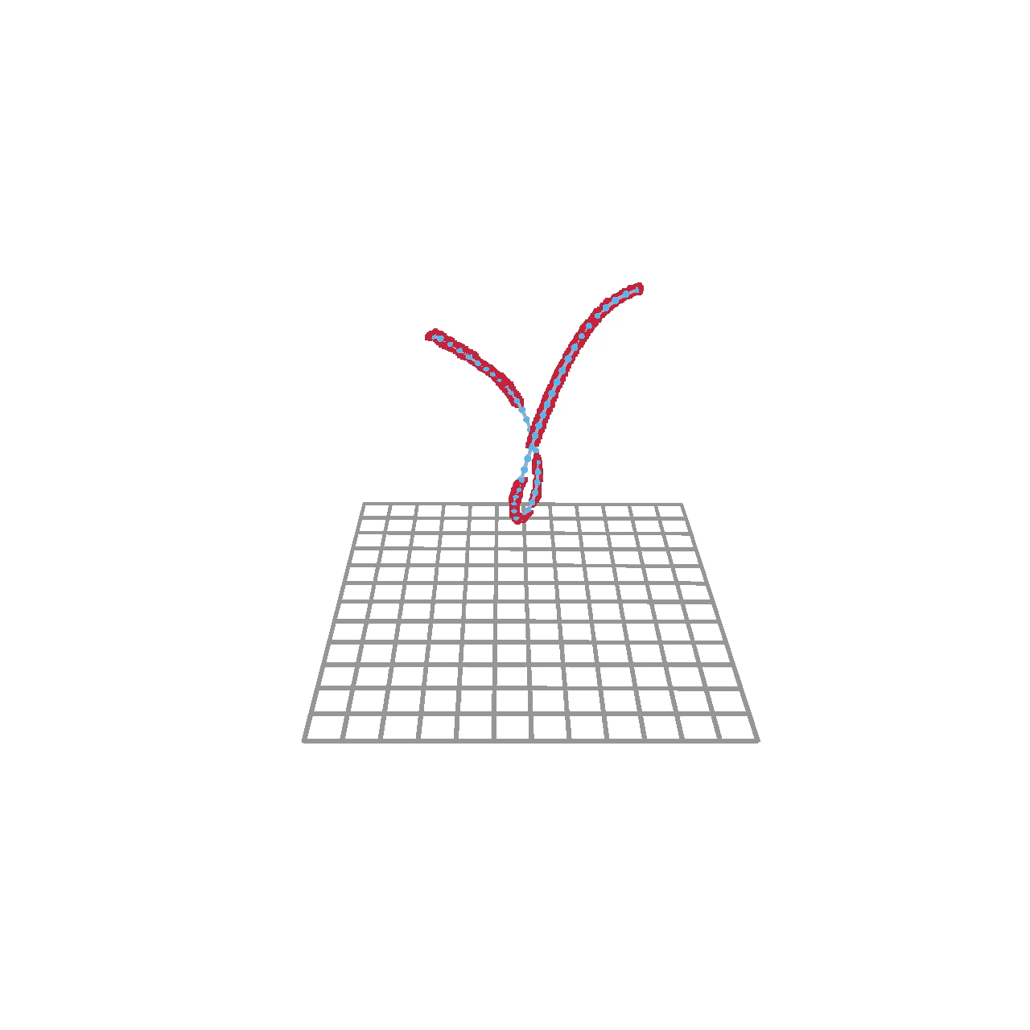
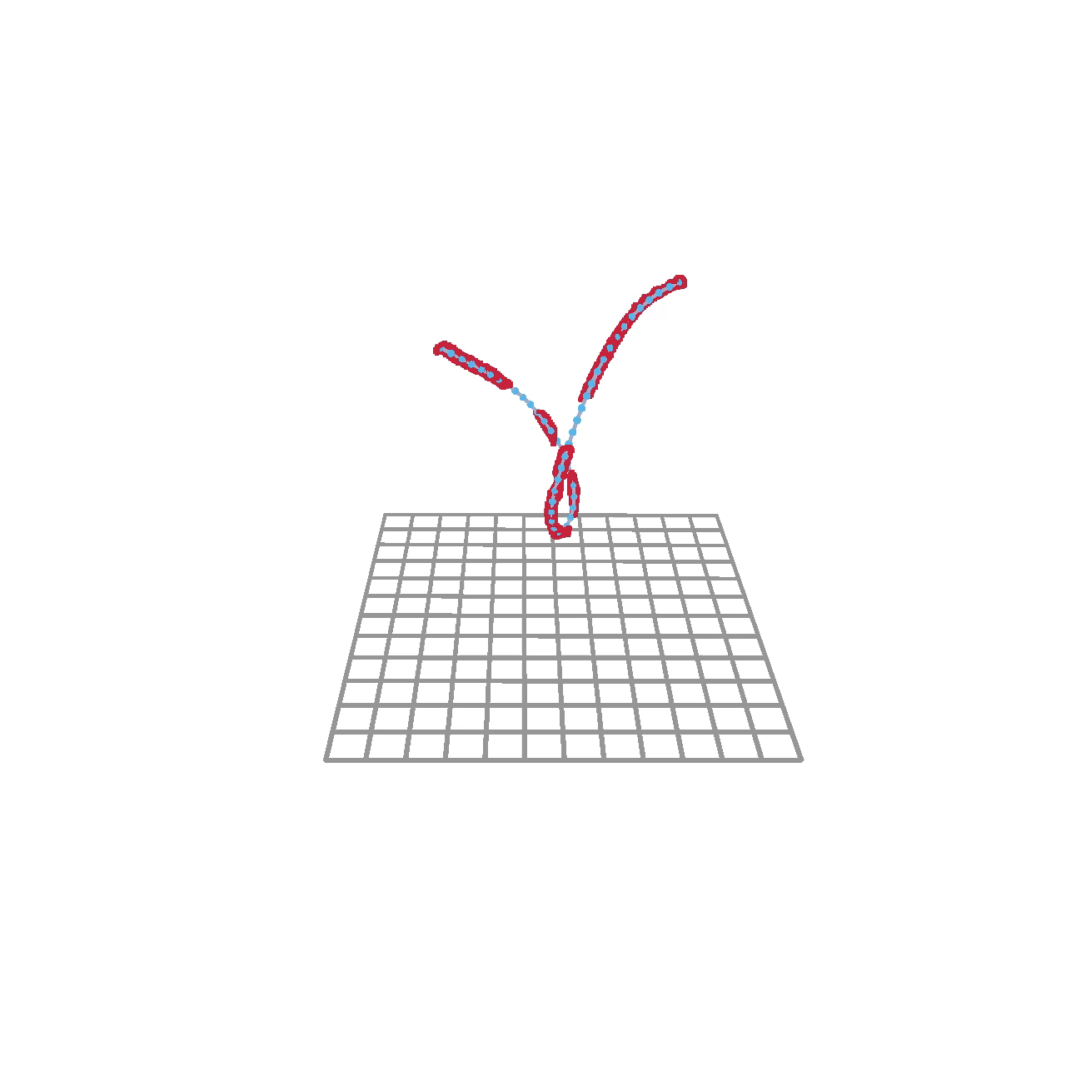
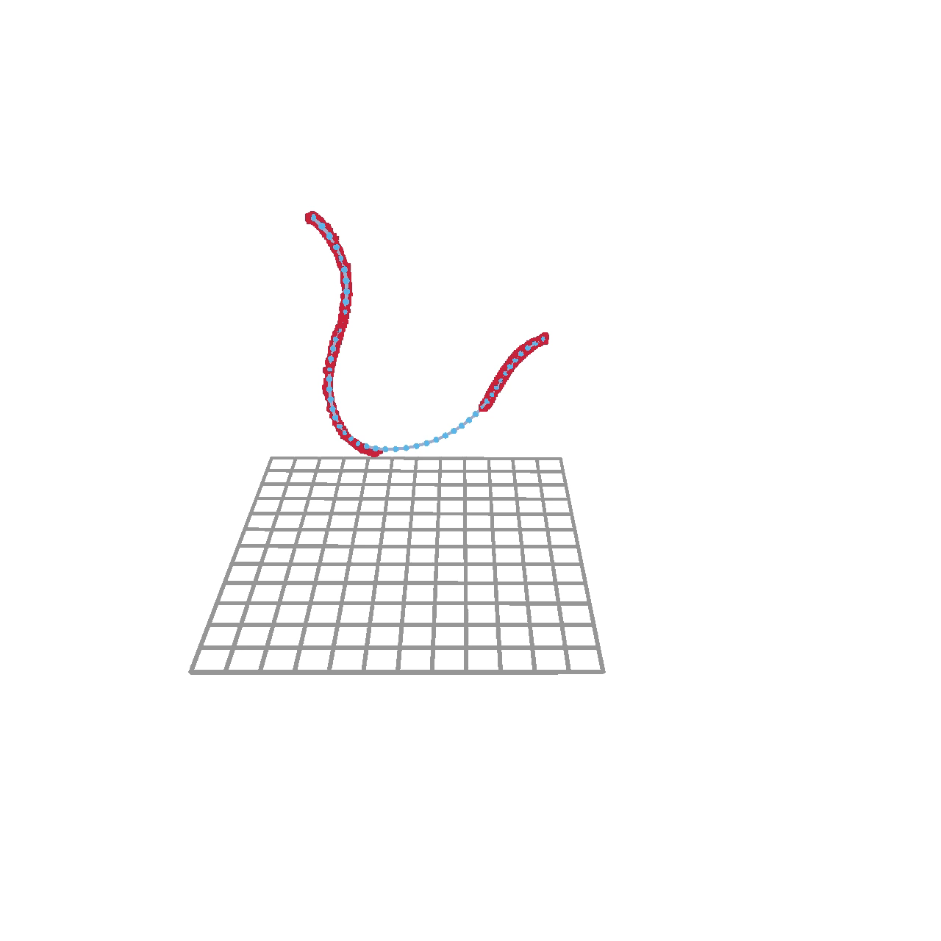
Experiments
Real-world Experiments—Inference Cases
Viewpoint Occlusion Self-intersection
Extensive Occlusion
Spatial Proximity Self-intersection
11

Slide 13
Contributions
Self-supervised Reconstruction Framework：Efficiently reconstructs DLO from partial point clouds.
Memory Module：Enhances completion by consolidating prototype information across samples.
DLO Shape Constraints：Leverages structural priors for better DLO representations.
12

Slide 14
Thank you !
For more details, please refer to our project website: https://mp2cdlo.github.io/MP2CDLO/

